Slide 1

QLD Vacancy Days Analysis in Public Housing
PROJECT 1
Alistair, Kaushal, Parvez and Selina

Slide 2
Definition
Vacancy Days – the number of days between the date such existing tenant vacates
Tenantable - (of a building) fit for occupation by a tenant.
Untenantable - incapable of being occupied or lived in
VUDays - Number of days the property was vacant and untenantable
VTDays – Number of days the property was vacant and tenantable

Slide 3
Types of Housing
Detached house
A house with 2 or more bedrooms on 1 block of land.
Duplex
Usually 2 units, with 1–3 bedrooms in each, divided by a common wall, located on 1 block of land.
Dual occupancy
2 properties located on one block of land.
Cluster house
A number of attached or separate homes, with 2–4 bedrooms in each, located within a housing development.
Townhouse
3 or more units next to each other, with 1–4 bedrooms in each, divided by common walls.
Apartment / flat / unit
Usually a complex of 2 or more storeys, with 1–3 bedrooms in each.
Seniors’ unit
For people over the age of 55, usually in a complex of 1–2 storeys, with 1–2 bedrooms in each.
→ https://www.qld.gov.au/housing/public-community-housing/eligibility-applying-for-housing/eligibility-for-housing/types-of-houses-provided

Slide 4
Eligibility for Housing
1. Australian citizenship and residency status
2. Queensland residency
3. No property ownership
4. Liquid asset test (Single – under $117k and 2 or more under $149k)
5. Independent Income ( $226.81 per week with proof of min 4 weeks)
6. Household income must fall below $609 to $1121 per week ( depending on family size)
7. Wellbeing
→ https://www.qld.gov.au/housing/public-community-housing/eligibility-applying-for-housing/eligibility-for-housing/check-your-eligibility

Slide 5
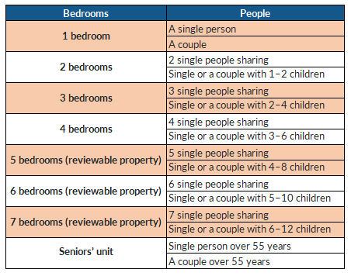
Bedroom entitlements
The number of bedrooms in the property
listed on the housing register
for is based on:
Number of people within your household
Gender of the people in your household
Age of the people in your household.
https://www.qld.gov.au/housing/public-community-housing/eligibility-applying-for-housing/eligibility-for-housing/types-of-houses-provided

Slide 6
Project Objectives
(1) What are the vacant days across 5 year period in QLD housing sector? (Graph 1)
(2) What was the status of the dwelling during vacant days (tenantable and untenable)? (Graph 2)
(3) How does unit size affect vacancy days? (Graph 3 )
(4) How does dwelling type affects the vacancy days? (Graph 4 to 6)
(5) Are there any factors that affected the vacancy days trend?
Null Hypothesis:

Slide 7
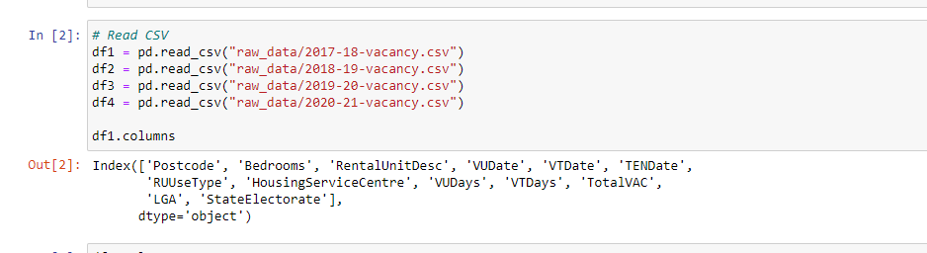
Data Cleanup and Exploration
- As per our Data collection reading the Csv file.

Slide 8
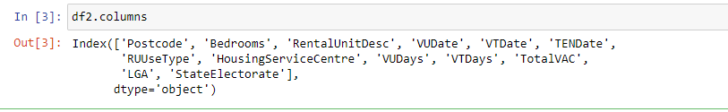
Data Cleanup and Exploration
- Check all the data frame with the same column name and same column sequence

Slide 9
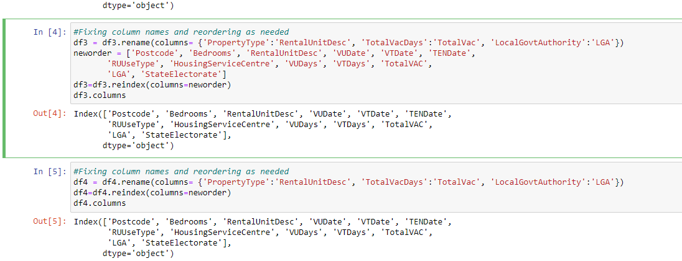
Data Cleanup and Exploration
- Change the difference of the columns of the data frame by renaming and changing oreders

Slide 10
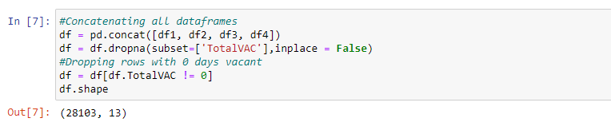
Data Cleanup and Exploration
- Drop all zero value rows of column Total Vacant Days

Slide 11
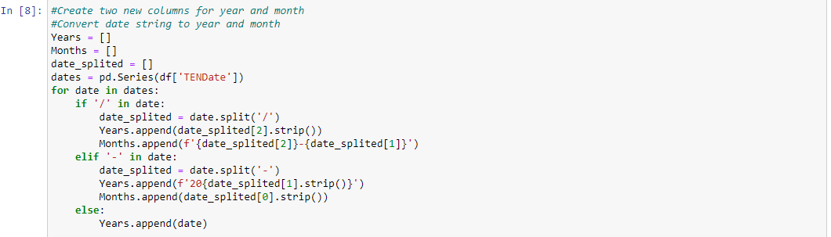
Data Cleanup and Exporation
- Create two new column Year and Months getting dates from the Dataframe

Slide 12
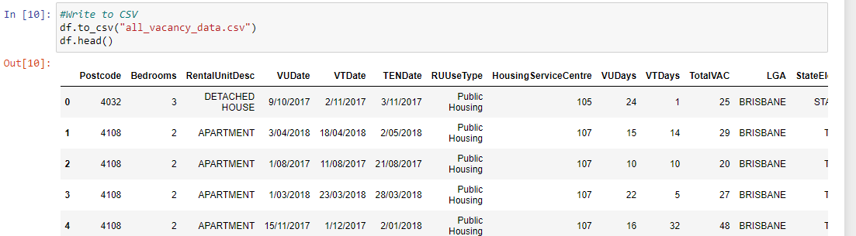
Data Cleanup and Exploration
- Save all data frame in new Csv file.

Slide 13
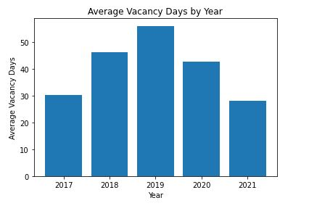
Average Vacancy Days by Year
-The Days on market called as DOM as well.
- In this Slide we would like to explain that how the average vacancy days increase and decrease by year.
- As we can see beginning of the 2020 vacancy rate dropping down around 45days and it still going down in 2021 which is approx. 30days.

Slide 14
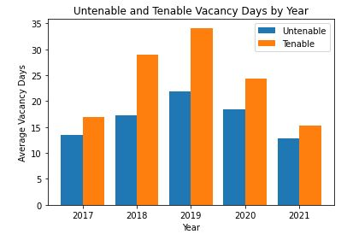
Untenable and Tenable Vacancy Days by Year
- In this graph as we are trying to compare the tenable and untenable house vacancy days by year.
-As we can see in 2017 graph shows a tenable vacancy rate is increasing upto the end of the 2019 which going upto the 33 days and suddenly it going down in 2020 and 2021. In the other side untenable is gradually increasing and decreasing during all this year but doesn’t have drastic change as like tenable.

Slide 15
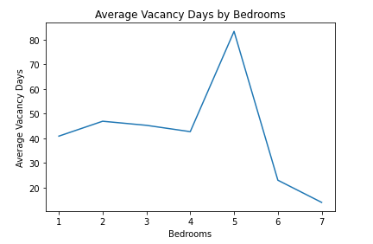
Average Vacancy Days by Bedrooms
- In this slide we are trying to explain the average vacancy days by bedroom and we found that bigger house or 5 bedroom house had more vacancy days than others.

Slide 16
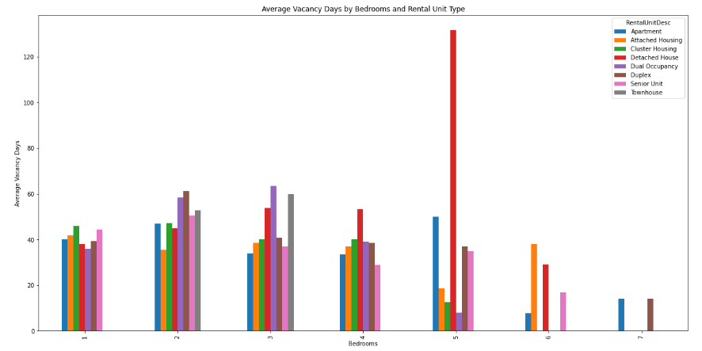
Housing types and bedroom comparison

Slide 17
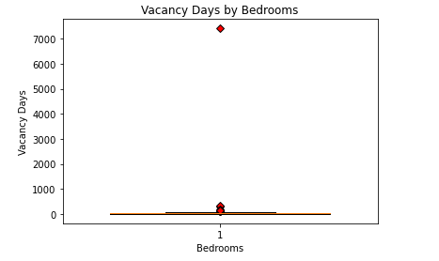
Outliers of vacancy days against bedrooms

Slide 18
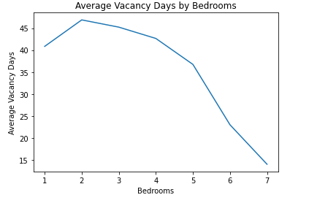
Average Vacancy Days against bedrooms
- Removing 3 outliers ( 7412, 326, 287)

Slide 19
Size of Dwelling

Slide 20
Null Hypothesis

Slide 21
Affects of Housing from Covid

Slide 22
Qld Housing Vacancy – Data Limitations
1 | 2 | 3 | 4

Slide 23
Discussion on Results

Slide 24
Conclusion

